Slide 1
NFR-01
NUCLEAR FUSION
THE “ITER” PROJECT
Speaker : Ricardo Gallo (Believe Green LLC, Chicago, USA)

Slide 2
INDEX
FISSION – FUSION
NUCLEAR FUSION
ADVANTAGES OF THE FUSION
  Radioactivity Level
  Specific energy density
COULOMB REPULSION - FUSION REACTION
THE ENERGY PRODUCED BY FUSION
THE TOKAMAK REACTOR
  500 MW of fusion power from 50 MW of input heating
  Diagram of the Relative Positioning of the Magnets
  The Composition of Magnetic Fields
  Toroidal Magnets
  Poloidal Magnets
  Central Solenoid
  Cryostat
  Blankets
  The Safety Factor , «q»
  Plasma Shaping
  Plasma Shaping. Typical Parameters
  Blankets - Tritium Generation (T)
  Heat Recovery Product
HEATING SYSTEMS
  Ohmic
  Neutral Beam Injection (NBI)
  Electromagnetic Waves - Dispersion Relationship Diagram
  Ion Cyclotron - (ICRH) - Electron Cyclotron (ECRH)
  Upper Hybrid (UH) and Lower Hybrid (LH)
  Powers and Frequencies
CONFINEMENT - Gravitational, Magnetic, Inertial
BURNING PLASMA - Fusion energy gain (Q)
TYPICAL SEQUENCE OF EVENTS IN A TOKAMAK DISCHARGE
CONSTRUCTION SITE (a)
CONSTRUCTION SITE (b)
Beyond ITER – DEMO
PRIVATE NUCLEAR FUSION PLANTS
CHRONOLOGY OF PUBLIC/PRIVATE INITIATIVES
CONCLUSIONS AND RECOMMENDATIONS

Slide 3
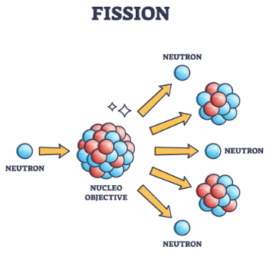
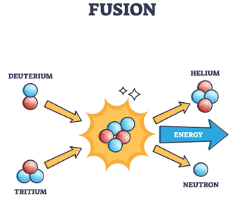
1.a - FISSION - FUSION
Reactions nuclear That they produce energy
Fission is the splitting of a heavy, unstable nucleus into two smaller nuclei. light
fusion is the process in which two light nuclei Yes they combine releasing large amount of energy

Slide 4
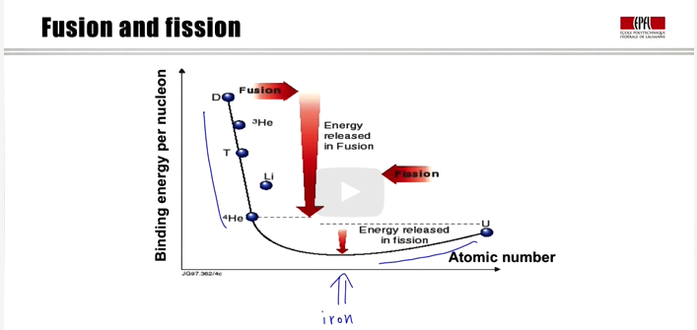
1.b - FISSION - FUSION
Binding energy per nucleus vs. number​ atomic
The reactions nuclear , whether fusion​ or those of fission , carry at the iron equilibrium state​
Fusion is the source of energy from the stars
In the sun: 10 million °C - In the earth: 150 million °C
Mass defect​ equal am=c²/E
For an idea of what happens in the sun, every minute , one mass which is equivalent to Mount Matterhorn , 4478 meters , located on the border between Switzerland and Italy.

Slide 5
2.a - NUCLEAR FUSION
Highlights
Fusion is the source of energy​ from the stars
In the sun: 10 million °C - In the earth: 150 million °C
Mass defect​ equal am=c²/E
"A star is plasma held together by its own gravity." In the core of the star, these gravitational forces create very high pressures and temperatures, which sustain the presence of the plasma.
For an idea of what happens in the sun, every minute , one mass which is equivalent to Mount Matterhorn , 4478 meters , located on the border between Switzerland and Italy.
November 25

Slide 6
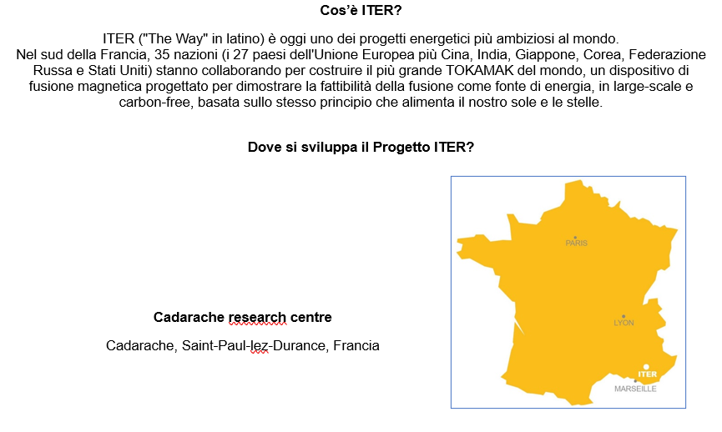
2.b - NUCLEAR FUSION
Main questions about the ITER project

Slide 7
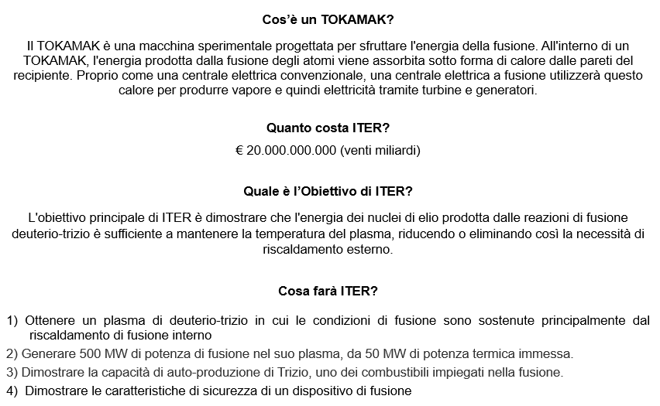
2.b - NUCLEAR FUSION
Main questions about the ITER project

Slide 8
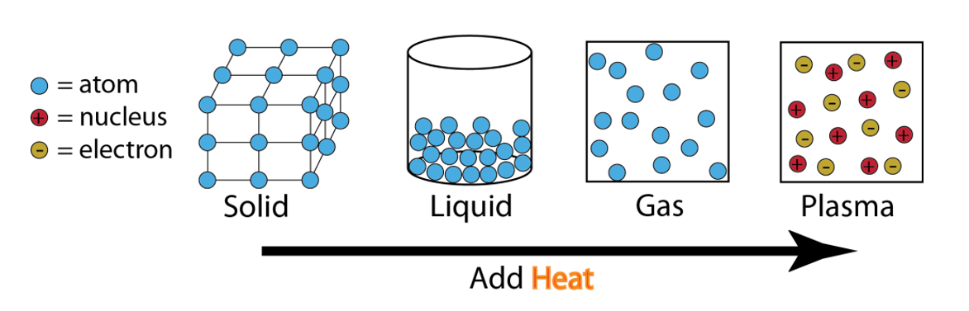
2.c - NUCLEAR FUSION
The State of Matter

Slide 9
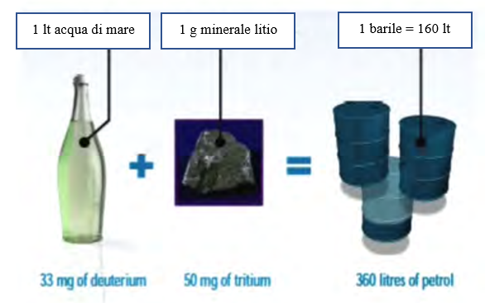
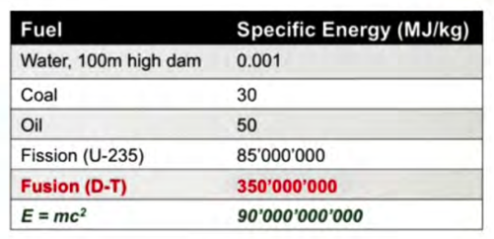
3.a - ADVANTAGES OF THE FUSION
Density energy specification​

Slide 10
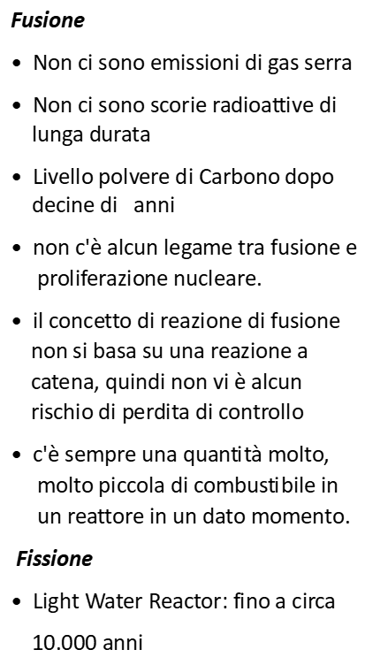
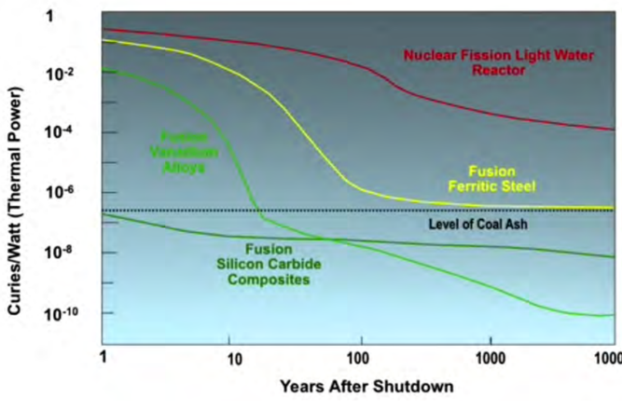
3.b - ADVANTAGES OF THE FUSION
Radioactivity
FISSION
Light Water Reactor
FISSION
Light Water Reactor
FUSION
Vanadium Alloy
FUSION
Ferritic Steel
Level of radioactivity
FUSION
Silicon Carbide Composites

Slide 11
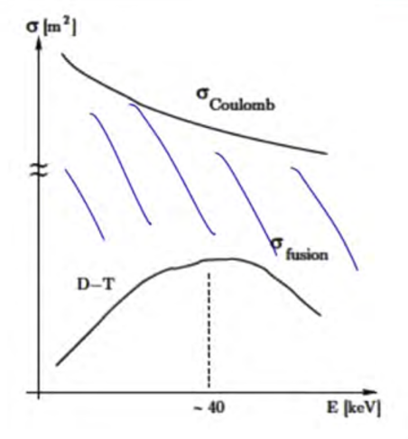
4th - COULOMB REPULSION - FUSION REACTION
Section of Shock
Section of Shock (Cross Section) ( σ )
It is the size of the target that an ion “ sees ” when interacts with another ion

Slide 12
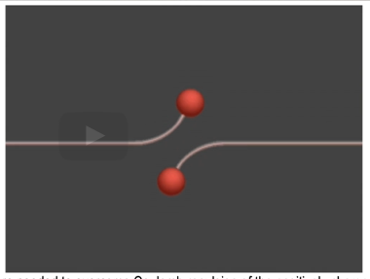
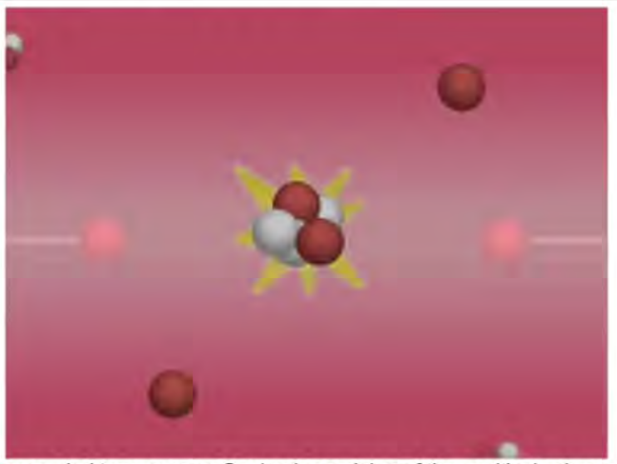
4.b - COULOMB REPULSION - FUSION REACTION
Section of Shock
All these particles are nuclei and therefore they are all positively charged so, they repel each other. due to Coulomb repulsion, far enough away that fusion reactions do not occur.
Unless the relative motion of these nuclei is strong enough or the collisions are energetic enough, they can get close enough and the nuclear force can take over.

Slide 13
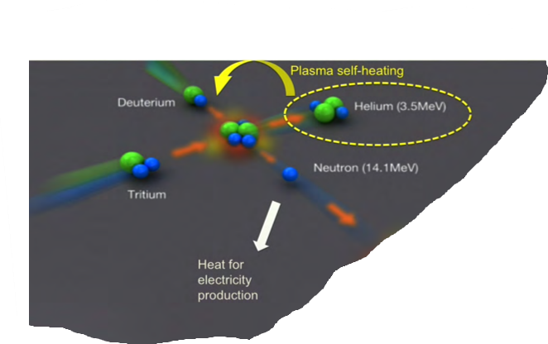
5. - THE ENERGY PRODUCED BY FUSION
The fusion between the nuclei of the hydrogen isotopes deuterium (D) and tritium (T) produces a helium nucleus, also called the "alpha particle", and a neutron.
The helium nucleus, which carries 20% of the energy produced by the fusion reaction, is electrically charged. It remains confined by the tokamak's magnetic fields and contributes to the continuous heating of the plasma. When heating by the helium nuclei dominates ("alpha heating"), the plasma is said to be a "hot plasma."
The neutron, which carries 80% of the energy produced by the fusion reaction, has no electric charge and is therefore unaffected by magnetic fields. It escapes from the plasma.
It is the impact of neutrons on the internal walls of the machine that generates heat, which in ITER will be evacuated, but which in future fusion plants will produce pressurized steam and start the process, through a turbine and an alternator, of producing electricity.

Slide 14
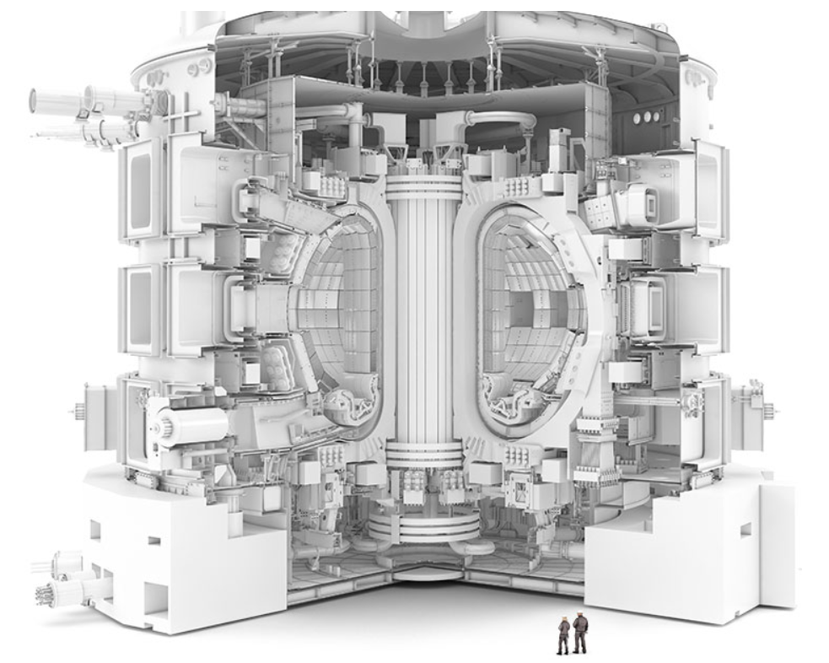
6.a - THE TOKAMAK REACTOR
500 MW of fusion power from 50 MW of input heating
measurement 24 m hight 30 m wide
plasma volume 830 m3
weight 23,000 tons

Slide 15
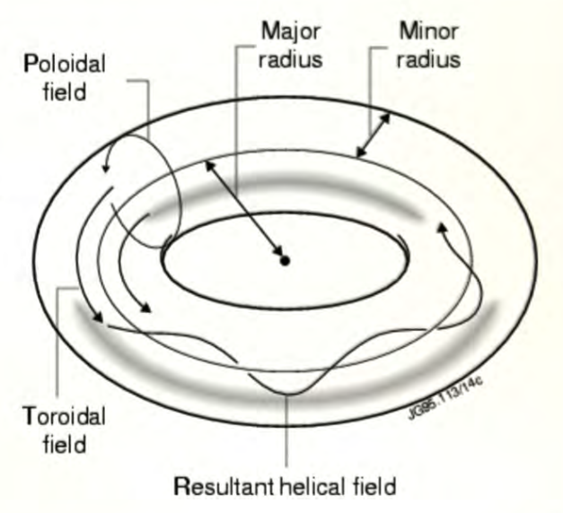
6.c - THE TOKAMAK REACTOR
The Composition of Magnetic Fields

Slide 16
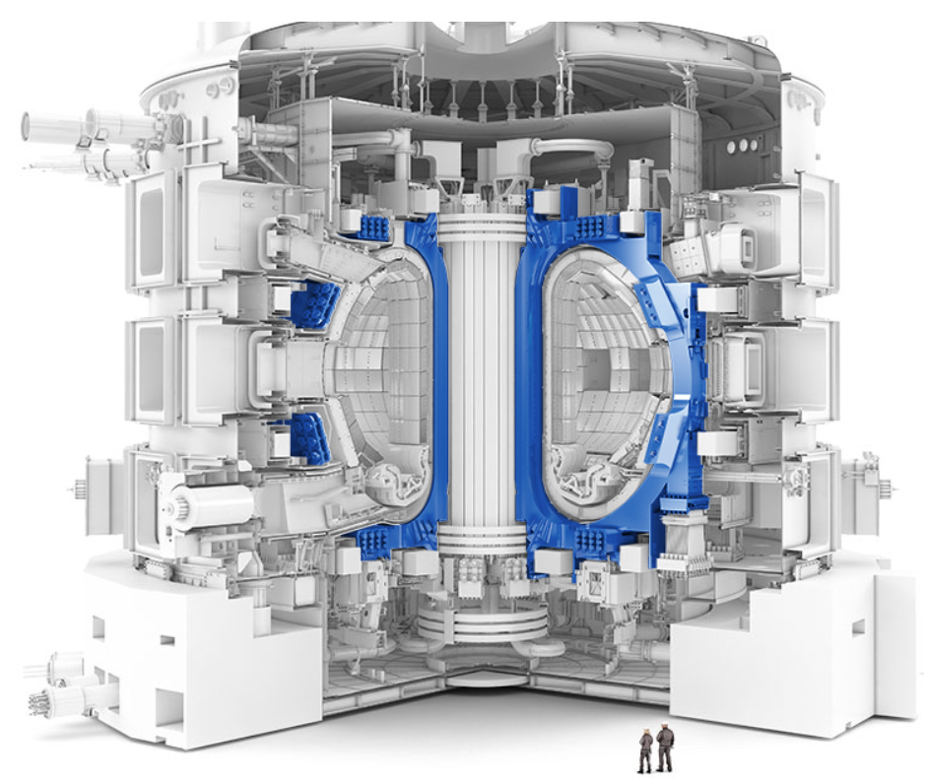
6.d - THE TOKAMAK REACTOR
Toroidal Magnets
magnetic field 11.8 Tesla
number 18
current 60,000 A
measurement 17 x 9 m
weight 320 Ton

Slide 17
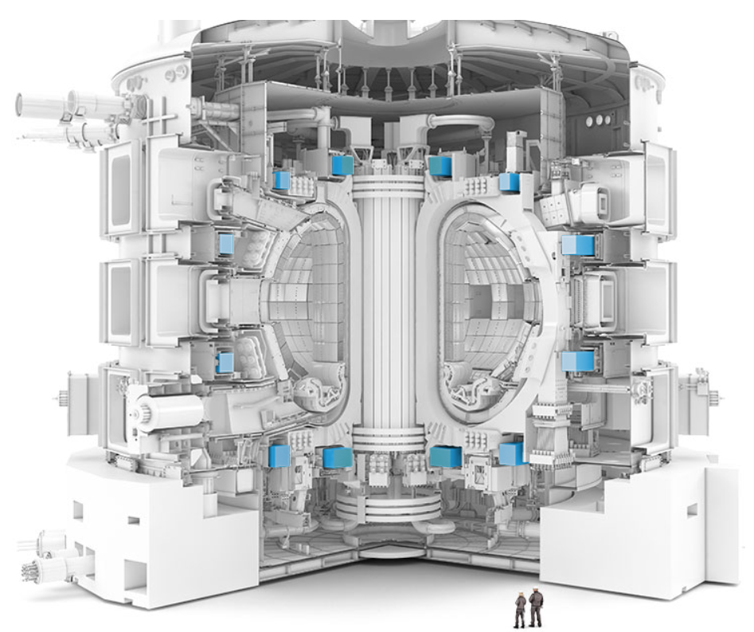
6.e - THE TOKAMAK REACTOR
Poloidal Magnets
number 6
diameter range 17-25 m
temperatures -269 °C
weight range 200-400 Tn

Slide 18
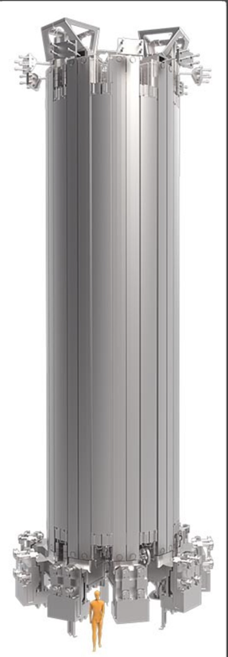
6.f - THE TOKAMAK REACTOR
Central Solenoid
magnetic field 13 Tesla
current 15,000 A
Height 18 m
diameter 4 m
weight 1,000 Tn

Slide 19
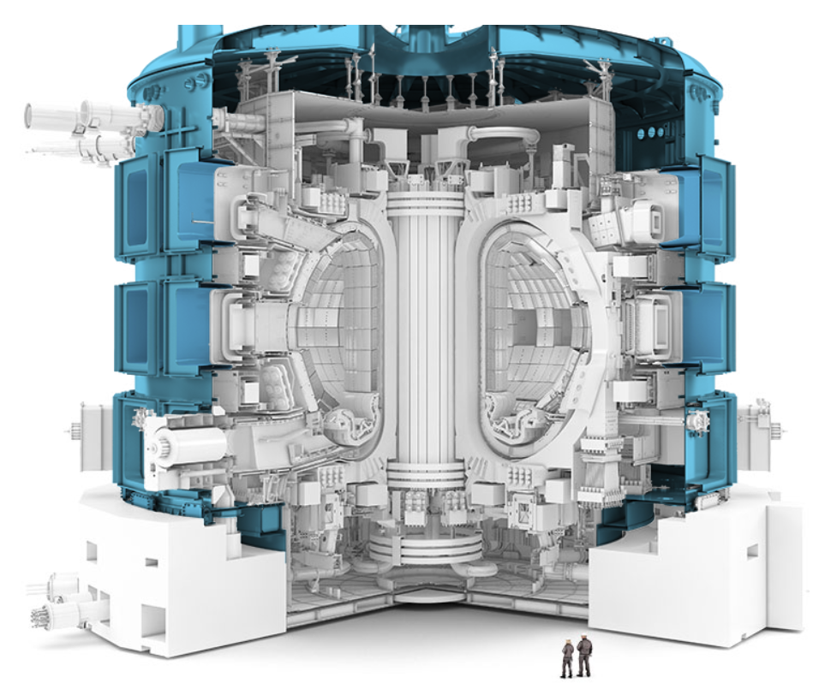
6.g - THE TOKAMAK REACTOR
Cryostat
Total Volume 16,000 m3
measurement 29 x 29 m
weight 3 900 Tn
The ITER cryostat provides the high-vacuum, ultra-cold environment for the Vacuum Vessel and superconducting magnets.

Slide 20
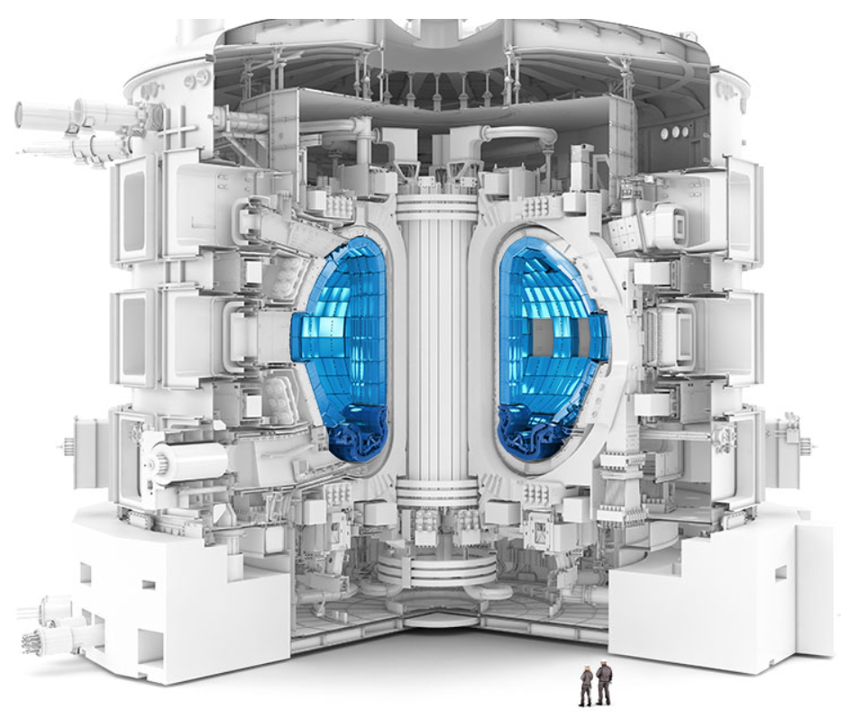
6.h - THE TOKAMAK REACTOR
Blankets
Functions
Protect the Vacuum Vessel and the external components of the machine from the high-energy neutrons produced during the fusion reaction.
Transfer the energy removed from the plasma by neutrons to a fluid (coolant)
Generate Tritium (T) which will later be used in the fusion reaction. ( TBM, Test Blanket Module)

Slide 21
6.i - THE TOKAMAK REACTOR
The Safety Factor , «q»
The Safety Factor , q, is the ratio of the toroidal field to the poloidal field .
There is a link between plasma stability and the Safety Factor.
Plasma instabilities are generally associated with fractional values of the Safety Factor (1/1 – 2/1 – 3/2).
The critical values (resonance condition) of m/n would then be 1/1, 2/1 and 3/2.
Usually we can decompose our perturbation into Toroidal Mode Numbers , n, and Poloidal Mode Numbers , m.
A (2,1) perturbation m=2, n=1 is a perturbation that makes two turns in the poloidal direction , m, while turning only once in the toroidal direction, n.

Slide 22
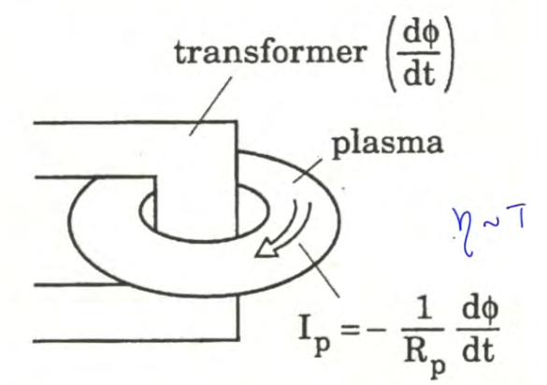
7.a - HEATING SYSTEMS
Ohmic
The primary coil of the transformer induces an electromotive force in the plasma ring which in turn produces a current through the plasma.
Plasma resistivity is proportional to T
This current is efficient in producing the poloidal field and must complete the structure of the magnetic field to trap the plasma in the tokamak.
This current becomes progressively less efficient at heating the plasma as its temperature increases.

Slide 23
6.i - THE TOKAMAK REACTOR
The Safety Factor , «q»
The Safety Factor , q, is the ratio of the toroidal field to the poloidal field .
There is a link between plasma stability and the Safety Factor.
Plasma instabilities are generally associated with fractional values of the Safety Factor (1/1 – 2/1 – 3/2).
The critical values (resonance condition) of m/n would then be 1/1, 2/1 and 3/2.
Usually we can decompose our perturbation into Toroidal Mode Numbers , n, and Poloidal Mode Numbers , m.
A (2,1) perturbation m=2, n=1 is a perturbation that makes two turns in the poloidal direction , m, while turning only once in the toroidal direction, n.

Slide 24
6.i - THE TOKAMAK REACTOR
The Safety Factor , «q»
The Safety Factor , q, is the ratio of the toroidal field to the poloidal field .
There is a link between plasma stability and the Safety Factor.
Plasma instabilities are generally associated with fractional values of the Safety Factor (1/1 – 2/1 – 3/2).
The critical values (resonance condition) of m/n would then be 1/1, 2/1 and 3/2.
Usually we can decompose our perturbation into Toroidal Mode Numbers , n, and Poloidal Mode Numbers , m.
A (2,1) perturbation m=2, n=1 is a perturbation that makes two turns in the poloidal direction , m, while turning only once in the toroidal direction, n.

Slide 25
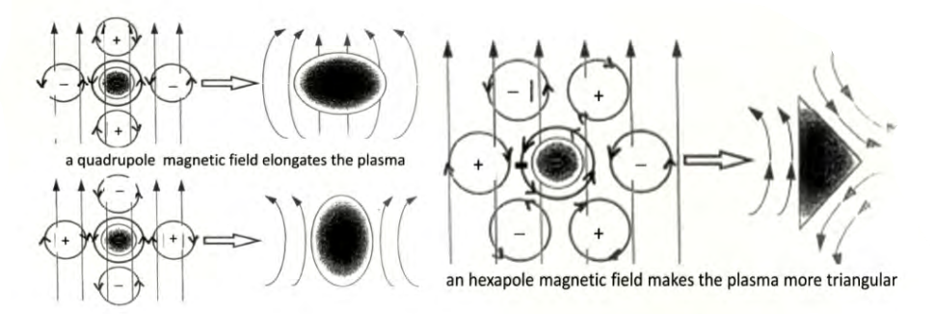
6.j - THE TOKAMAK REACTOR
Plasma Shaping
The plasma shaping is produced by the external poloidal field , so it starts from a superposition of magnetic fields produced by the coils and the plasma current.
poloidal fields serve to control the radial position of the plasma, the vertical position of the plasma and produce plasma shaping.
Plasma shaping is very important because it is one of the possible methods we have to control instabilities and optimize the performance of a fusion reactor.

Slide 26
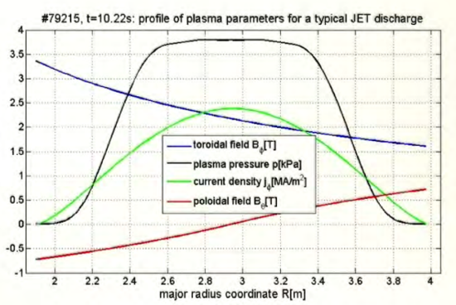
6.k - THE TOKAMAK REACTOR
Plasma Shaping - Typical Parameters

Slide 27
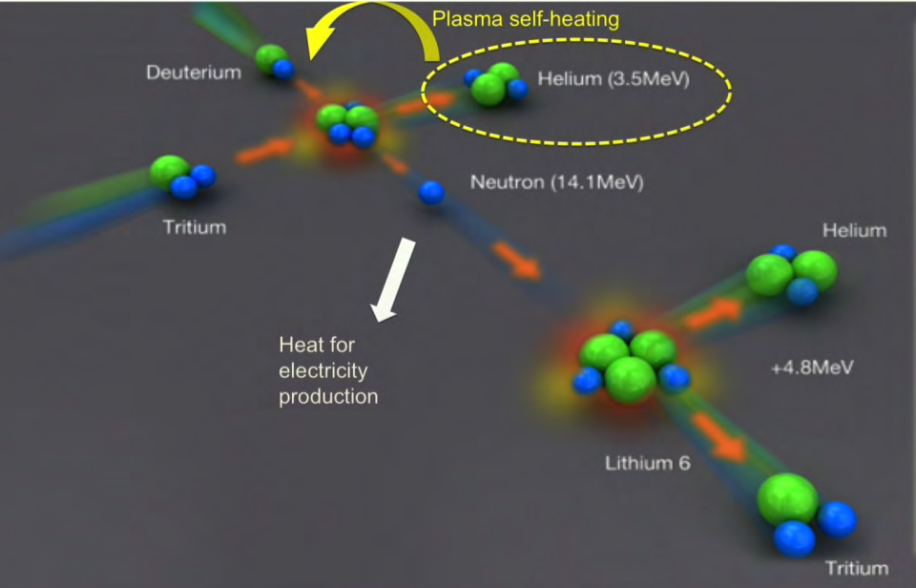
6.l - THE TOKAMAK REACTOR
Blankets - Tritium Generation ( T)

Slide 28
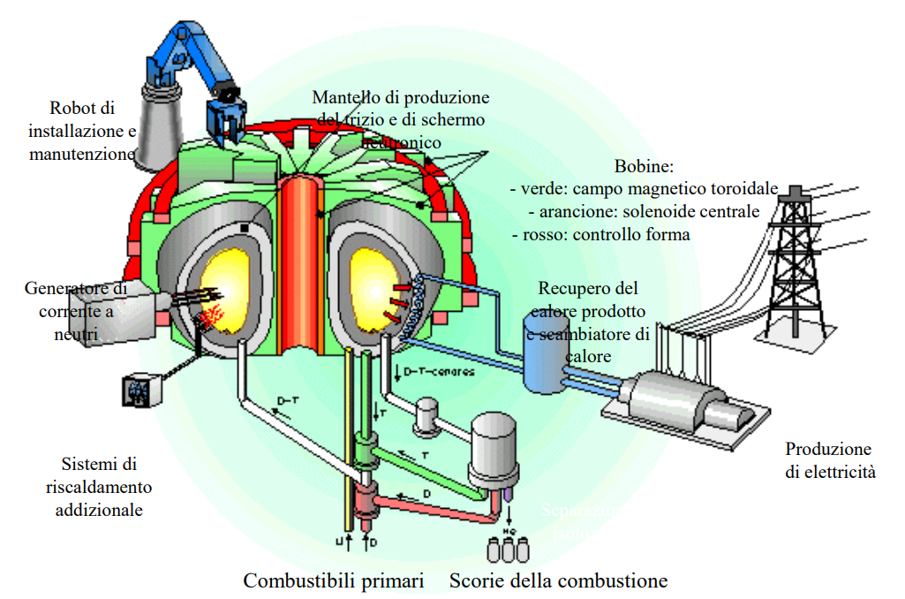
6.m - THE TOKAMAK REACTOR
Heat Recovery Product

Slide 29
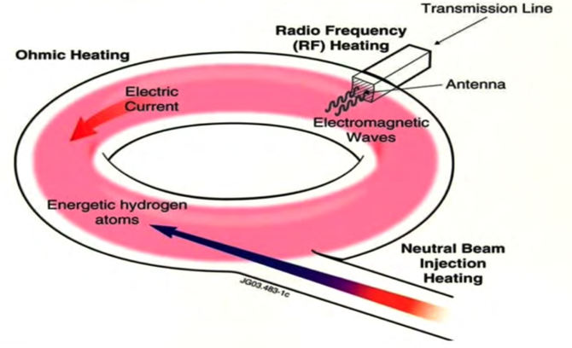
7. - HEATING SYSTEMS
4 Heating Systems :
Internal
Ohmic Heating
Exteriors
Neutral Beam Injection (NBI) - (33 MW)
Ion Cyclotron Resonance Heating (ICRH) - (20 MW)
Electron Cyclotron Resonance Heating (ECRH) - (20 MW)
73 megawatts of plasma heating is available, well above the 50 megawatts required.

Slide 30
7.a - HEATING SYSTEMS
Ohmic
The primary coil of the transformer induces an electromotive force in the plasma ring which in turn produces a current through the plasma.
Plasma resistivity is proportional to T
This current is efficient in producing the poloidal field and must complete the structure of the magnetic field to trap the plasma in the tokamak.
This current becomes progressively less efficient at heating the plasma as its temperature increases.

Slide 31
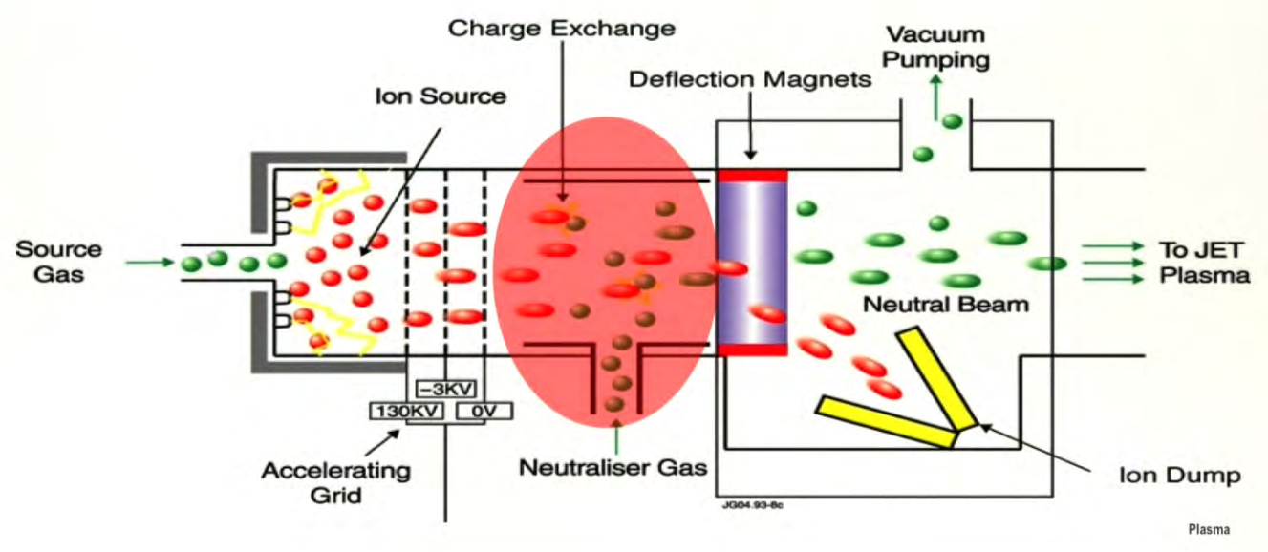
7.b - HEATING SYSTEMS
Neutral Beam Injection (NBI)
Need to heat the plasma by means other than ohmic power.
We can heat the plasma by injecting a beam of highly energetic neutral particles
How can we inject a beam of ions into a magnetic field?
• Injection of a beam of high-energy neutral particles. That is, they are unaffected by the magnetic field.
• They will become ions once they enter the plasma.
• The energetic ion beam can transfer its energy to the ions and electrons in the plasma through Coulomb collisions.
• The plasma will then heat up.

Slide 32
7.c - HEATING SYSTEMS
Electromagnetic Waves - Dispersion Relation Diagram
Injection of electromagnetic waves
The heating effect can be combined with non-inductive current conduction. Non-inductive means a current that is not based on the transforming action.
We can use this non-inductive current to locally modify the current profile and cure instabilities.
Magnetized plasmas allow the propagation of various wave modes. These modes can be analyzed by formulating dispersion relation diagrams .
Waves are characterized by their own parameters that identify them (Frequency, Length, Number, etc. )
Absorption of the energy transferred to the plasma by the waves occurs when resonances occur between the waves and the plasma.
So we have to control the excitation, propagation and absorption of the waves to recreate the wave modes capable of producing resonances.

Slide 33
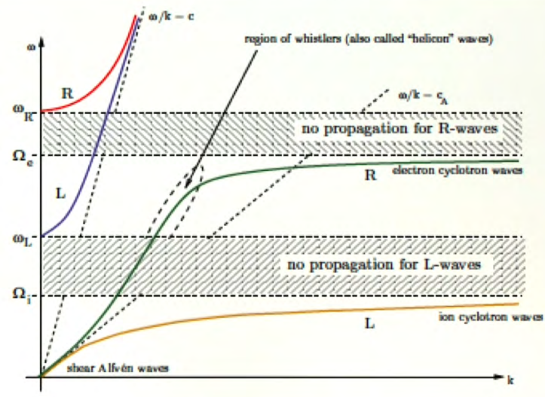
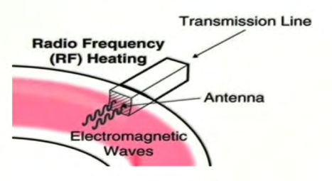
7.d - HEATING SYSTEMS
Ion Cyclotron (ICRH) - Electro Cyclotron (ECRH)
• Wave direction
Perpendicular to the local ambient magnetic field, B₀
• Propagation mode
o Polarization (R) - clockwise rotating electric field that resonates with the electron population ( Ωe )
o Polarization (L) - clockwise rotating electric field that resonates with the ion population ( Ωi )
So we see that we have two resonant frequencies at which we could transfer energy into the plasma using waves .

Slide 34
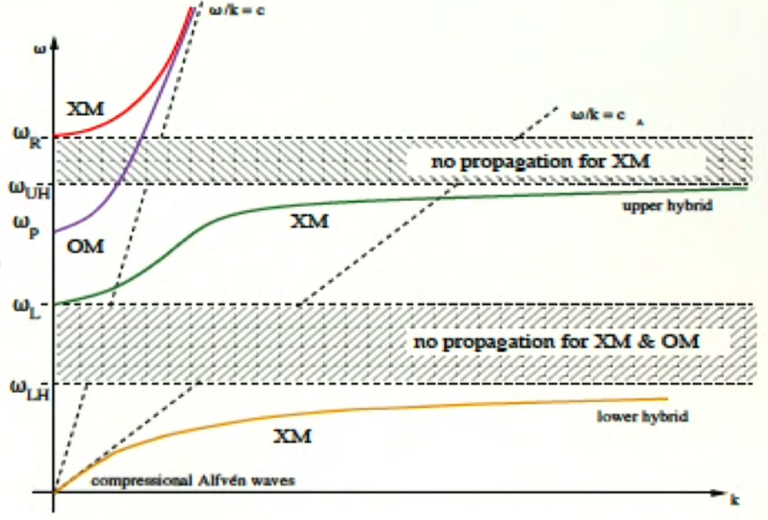
7.e - HEATING SYSTEMS
Upper Hybrid and Lower Hybrid - (UH) (LH)
• Wave direction
Parallel to the local ambient magnetic field, B ₀
• Propagation mode
UH, Upper Hybrid
LH, Lower Hybrid
Launching parallel waves is generally quite complicated if the device has a toroidal geometry.
Hybrid Mode is mainly used for current driving

Slide 35
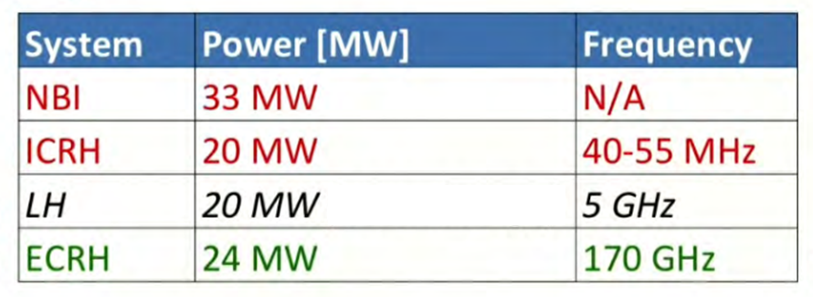
7.f - HEATING SYSTEMS
Powers and Frequencies

Slide 36
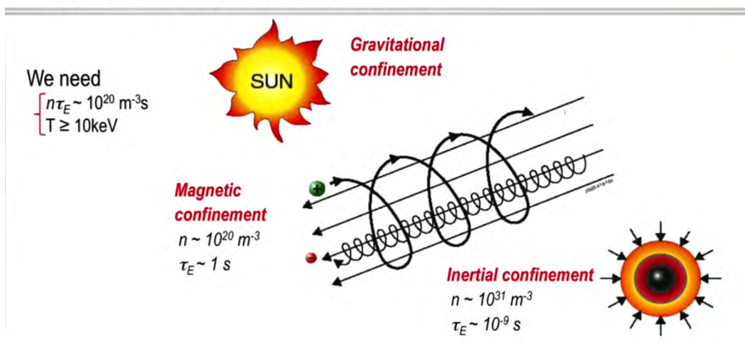
8. - CONFINEMENT
Gravitational - Magnetic - Inertial
« Confinement Quality »
(The Product " η * τ E“)
η = Density
τ E = Energy Confinement Time (“ represents the duration for which the energy produced by the fusion reactions within the plasma is retained before being dispersed into the surrounding walls“)
We need → η * τ E ~ 10 ²⁰ m ⁻³ s

Slide 37
9. - BURNING PLASMA - FUSION ENERGY GAIN (Q)
Variation of the energy contained in a plasma
dW /dt = P α + P in – W/ τ E
a-heating ext. heating direct losses
Fusion n energy gain
Q = P _{fusion} /P _{in} = 5 P α /P _{in} as Pα = 0.2 P _{fusion}
α heating fraction: f α = P α /( P (α +Pin) = Q/(Q+5)
Q < 0.7 f α < 12% ( present experiments)
Q = 1 f α = 17% ( breakeven)
Q = 5 f α = 50%
Q = 10 f α = 67%
Q = ∞ fα = 100% ( ignition )

Slide 38
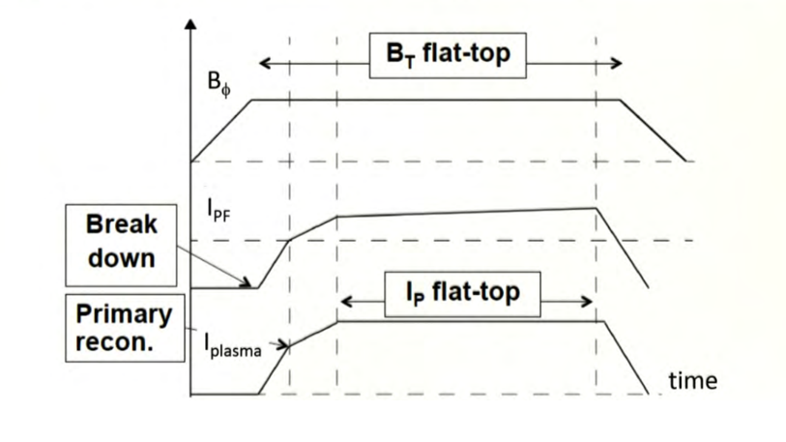
10. - TYPICAL SEQUENCE OF EVENTS IN A TOKAMAK DISCHARGE
Today's tokamaks produce plasma in short bursts ( pulses ) lasting from 1 to 20 seconds. The ITER experimental reactor is equipped with superconducting magnetic coils and will achieve discharge times of up to a quarter of an hour.
Current in the primary field coils, Ipf , starting with a negative value.
Injection of gas into the plasma, not much: about 0.01 grams
The current in the primary field coils increases.
The plasma current also begins to increase.
When the current in the primary field coils approaches zero, this is what is called the primary reconnection current.
If the disturbance has been eliminated, we continue to increase the current
poloidal field coil .
The plasma current increases. We reach a flat top and descend at the end of the discharge.
For the magnetic field, we usually start with premagnetization.

Slide 39
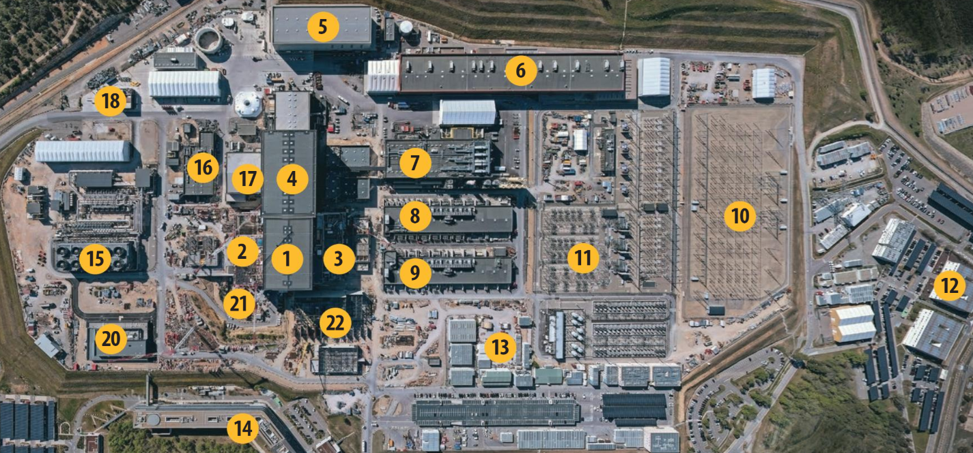
11. - CONSTRUCTION SITE (to)

Slide 40
12 . - CONSTRUCTION SITE (b)
1 – TOKAMAK Building | 13 – CONTRACTORS AREA
2 – TRITIUM Building | 14 – ITER HEADQUARTERS
3 – DIAGNOSTICS Building | 15 – HEAT REJECTION System – The heat rejection system is dimensioned to dissipate the heat generated by ITER operation.
4 – TOKAMAK Components – Assembly Room | 16 – SERVICE BUILDING – It houses a large number of industrial support services (refrigeration systems for air conditioning, demineralized water, air compressors, etc.)
5 – CRYOSTAT – Assembly Room - A vacuum vessel built around the superconductors that provides thermal insulation to keep the magnets cool. | 17 – RADIOFREQUENCY Building – Equipped with power supplies and energy converters for radiofrequency heating of the ITER plasma
6 – POLOIDAL COILS – Manufacturing room | 18 – TOKAMAK ASSEMBLY PREPARATORY BUILDING – Designed for the storage and handling of plasma-related components; currently used for assembly activities
7 – CRYOPLANT – Liquid helium and liquid nitrogen production site, used to cool Tokamak components | 19 – WAREHOUSE – Storage of medium-sized components.
8-9 – MAGNET POWER CONVERSION Buildings – Houses the equipment for converting alternating current into direct current for magnets | 20 – CONTROL BUILDING – Machine monitoring and data analysis will be performed in this 500 m2
10 – 400 KV SWITCHBOARD – The ITER facility is connected to the French national grid (RTE) by way of this 400 kV switchyard | 21 – HOT CELL – Future location of the Hot Cell Facility.
11 – SWITCHING PROCEDURE – Two distinct networks, one “stationary” and the other “pulsed”, distribute energy to the machine and plant systems | 22 – NEUTRAL BEAM POWER SUPPLY - Neutral beam injection power supply equipment.
12 - OFFICES

Slide 41
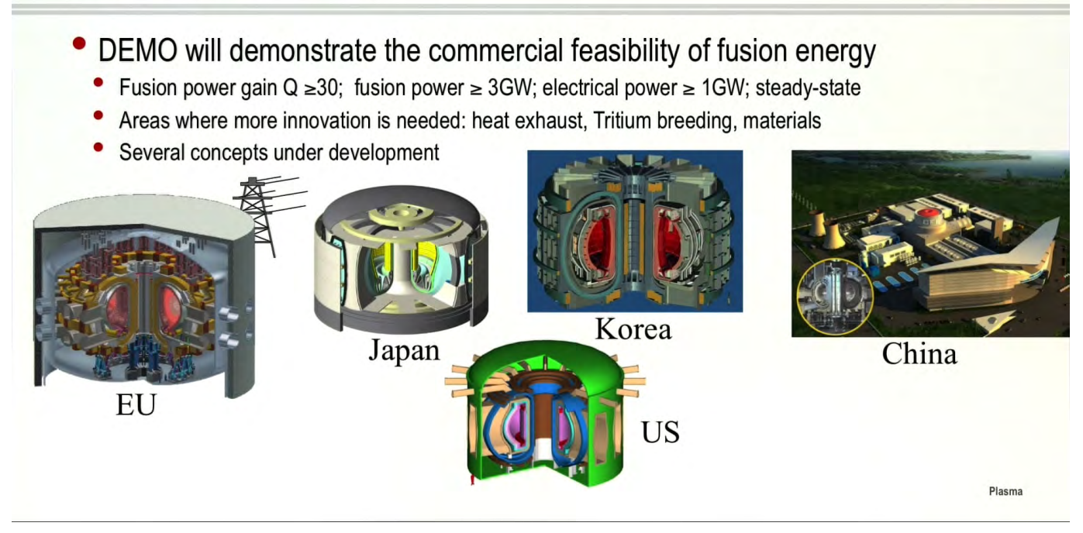
13 . - Beyond ITER - DEMO

Slide 42
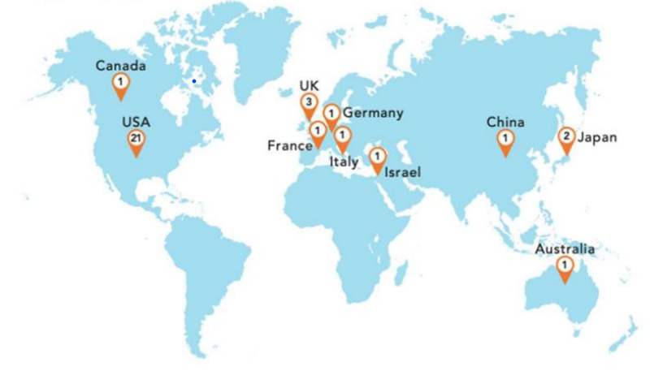
14. - PRIVATE NUCLEAR FUSION

Slide 43
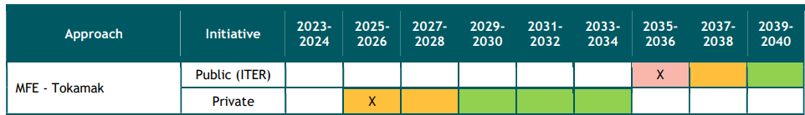
15 . - CHRONOLOGY OF PUBLIC/PRIVATE INITIATIVES
( source : Study commissioned by the European Commission's DG Energy to Trinomics BV of Rotterdam)
IFE → Inertial Fusion Energy
x = expected date for the next device;
The color coding represents the slip risk assessment:
red = high risk of slippage from this year;
orange = medium risk of slippage from this year;
green = low risk of slippage in this period

Slide 44
16 . - CONCLUSIONS AND RECOMMENDATIONS
( source : Study commissioned by the European Commission's DG Energy to Trinomics BV of Rotterdam)
Fusion roadmaps are under development in several countries around the world. Private fusion initiatives are likely to reach net energy production between 2024 and 2028.
Generally, it is necessary to develop technologies better suited to the nuclear environment. Industry must be involved in the progress towards the DEMO phase, towards a nuclear-electric fusion reactor.
Materials are a crucial element of casting technology. Materials issues still need to be explored in greater depth.
Superconducting magnets need to be optimized for high fields.
A comprehensive understanding of the tokamak's steady-state operation at high magnetic field, high density, and high temperature is needed.
Huge progress has been made in controlling the plasma (and its instabilities), but the complete control of fast ions, for example, is still lacking.
The best magnetic configuration to optimize the plasma discharge still needs to be found.
Staffing is likely to become increasingly problematic in the coming years, so ensuring a supply of qualified scientists, engineers, and technicians will be critical.
Massive industrial efforts are needed to scale up the deployment of fusion energy once the first commercial power plants are operational. It is important to consider how supply chains can be prepared to accommodate the scale of this opportunity.

Slide 45
THANK YOU FOR YOUR PARTICIPATION

